Slide 1
Chapter 1: Introduction to Networking
Outcome:
You’ll be able to explain all five layers of network model.
You’ll be able to identify and describe each layer and what purpose it serves.
You’ll be able to identify and describe various networking cables and devices.
You’ll be able to have deep understanding in Physical and Datalink Layer.
You’ll be able to understand TCP/IP utilities/commands e.g -ipconfig, ping, netstat, arp, nslookup, traceroute

Slide 2
1.1 Introduction
Networking is critical today.
Computer networking is understanding how a system communicates with another system.
The defined set of standards that computers must follow in order to communicate properly is called a protocol.
Computer networking is the name given to the full scope of how computers communicate with each other.
Networking involves ensuring that computers can communicate with each other and use protocols that others can understand.
There are lots of models used to describe the different layers at play with computer networking.

Slide 3
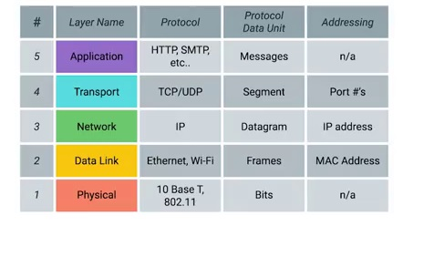
1.2 The TCP/IP Five‐Layer Network Model

Slide 4
Quiz Time
Generally, on what layer the router resides on any network?
A. Layer 1
B. Layer 2
C. Layer 3
D. None of the above
Correct Answer: C

Slide 5
1.3 Basic Networking devices
Cables - Connect different devices to each other allowing data to be transmitted over them.
Hubs - physical layer device that allows for connections from many computers at once.
Switches - hardware device that channels incoming data from multiple input ports to a specific output port that will take it toward its intended destination
Routers - device that knows how to forward data between different networks.
Clients - any machine that is receiving the data or a service in a network.
Servers - any machine that is providing the data or a service to a client in a network.

Slide 6
1.4 The Physical Layer
Bit - Is the smallest representation of data that a computer can understand.
Modulation - Ones and zeros are sent across those network cables through a process called modulation.
Twisted Pair Cabling - The most common type of cabling used for connecting computing devices is known as twisted pair.
Duplex communication - Duplex communication is the concept that information can flow in both directions across the cable.
Network Ports - The most common plug is known as an RJ‐45 or Registered Jack 45. A network cable with an RJ‐45 plug can connect to an RJ‐45 network port.
Patch Panels - Is a device containing many net ports but it does no other work.

Slide 7
1.5 Data link Layer
Ethernet - The protocol most widely used to send data across individual links.
MAC Address - Globally unique identifier attached to an individual network interface
Unicast - The unicast address will have the value of the MAC address of the destination device.
Multicast Frames- These are frames that are transmitted to a select group of destinations.
Broadcast - An Ethernet broadcast is sent to every single device on a LAN.
Data packet - is a term that represents any single set of binary data being sent across a network link.

Slide 8
Questions ???

Slide 9
Lab Practice
TCP/IP utilities-ipconfig, ping, netstat, arp, nslookup, traceroute

